Slide 1

Winemonger
Web Application for Inventory Management
Submitted by,
JISNA SALEEM
Under the guidance of,
Dr Santhosh Kottam

Slide 2
Relevance Of the Topic
As a retailer of premium wines, Winemonger may benefit from implementing an inventory management system for several reasons:
Accurate inventory tracking: With an inventory management system, Winemonger can accurately track the quantity and location of its wine inventory across multiple warehouses and retail locations. This can help the company avoid stockouts, prevent overstocking, and improve overall inventory accuracy.
Streamlined order fulfilment: By automating inventory management processes, Winemonger can more efficiently fulfil customer orders and reduce the time it takes to pick, pack, and ship products. This can lead to faster delivery times and improved customer satisfaction.
Cost savings: An inventory management system can help Winemonger reduce the costs associated with carrying excess inventory, cost of labour.

Slide 3
Improved forecasting: Winemonger can improve its forecasting and planning processes, better anticipate demand for certain products, and make informed purchasing decisions.
Enhanced reporting: An inventory management system can provide Winemonger with valuable data and insights about inventory levels, sales trends, and product performance. This can help the company make data-driven decisions about inventory levels, product offerings, and sales strategies.
Overall, implementing an inventory management system can help Winemonger improve its inventory control, order fulfillment, cost efficiency, forecasting, and reporting. This can lead to improved customer satisfaction, increased revenue, and a more efficient and effective business operation

Slide 4
About the project
Winemonger is an online retailer of premium Austrian and German wines.
The company specializes in bringing high-quality, small-batch wines from family-owned wineries in Austria and Germany to customers in the United States.
Winemonger offers a wide selection of wines, including white, red, and sparkling wines, as well as dessert wines and spirits.
Winemonger's inventory management system likely allows the winemonger admin to create and manage order tasting,reservation track inventory levels, manage stock, and reorder products as needed.
They also use the system to generate reports that provide insights into inventory levels, sales trends, and other key metrics.
With a well-functioning inventory management system, Winemonger can ensure that they always have the right products in stock and avoid stockouts, while minimizing the risk of overstocking and reducing waste

Slide 5
Objective of the Study
The objective of Winemonger's inventory management system is to efficiently manage their wine inventory to ensure that they always have the right products in stock, while minimizing the risk of stockouts, overstocking, and waste.
The inventory management system helps Winemonger keep track of their inventory levels, sales trends, and other key metrics to make informed decisions about inventory levels, ordering, and sales strategy.
By achieving these goals, Winemonger's inventory management system can help them improve customer satisfaction, increase sales, and reduce costs associated with managing their wine inventory.

Slide 6
Existing System
Without an inventory management system, wineries can face several limitations that can negatively impact their operations and profitability. Some of these limitations include:
Inaccurate inventory tracking: Without an inventory management system, wineries may rely on manual processes to track inventory levels, which can be time-consuming and prone to errors. This can result in inaccurate inventory levels, leading to overstocking, stockouts, and lost sales.
Poor production planning: Without accurate inventory data, wineries may struggle to plan production effectively. This can lead to overproduction, increased waste, and reduced profitability.
Inefficient supplier management:. This can lead to delays in the delivery of raw materials, increased costs, and reduced efficiency.
Limited reporting and analytics: Without an inventory management system, wineries may lack access to real-time data on inventory levels, production performance, and sales performance. This can limit their ability to make data-driven decisions, leading to missed opportunities for improvement.

Slide 7
Proposed System
Real-Time Inventory Tracking: The system would provide real-time tracking of inventory levels, including raw materials, work-in-progress (WIP), and finished goods.
Supplier Management: The system would include supplier management tools to track supplier performance, manage purchase orders, and ensure timely delivery of raw materials.
Sales and Distribution Management: The system would include sales and distribution management tools to manage customer orders, track shipments, and optimize delivery routes.
Reporting and Analytics: The system would provide real-time reporting and analytics on inventory levels, production performance, and sales performance, enabling to make data-driven decisions about inventory management and production planning.

Slide 8
Modules
Order management
Tasting management
Reservation management
Product management
Warehouse management
Customer management
Report generation and analatyics

Slide 9
Description of system design
Front end :HTML,CSS,Angular.
Back end :Java spring boot
IDE:visual studio code

Slide 10
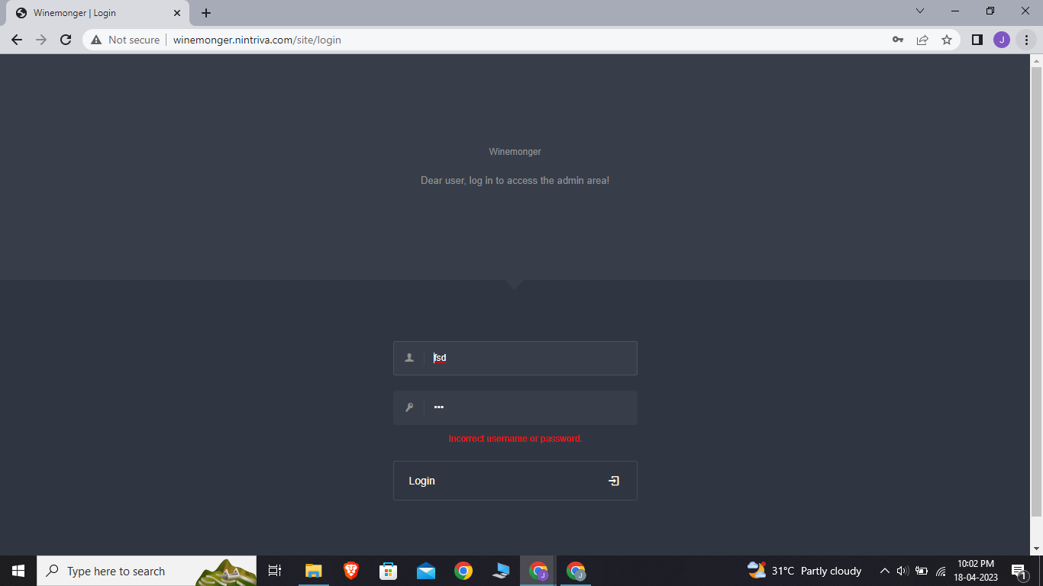
Login page

Slide 11
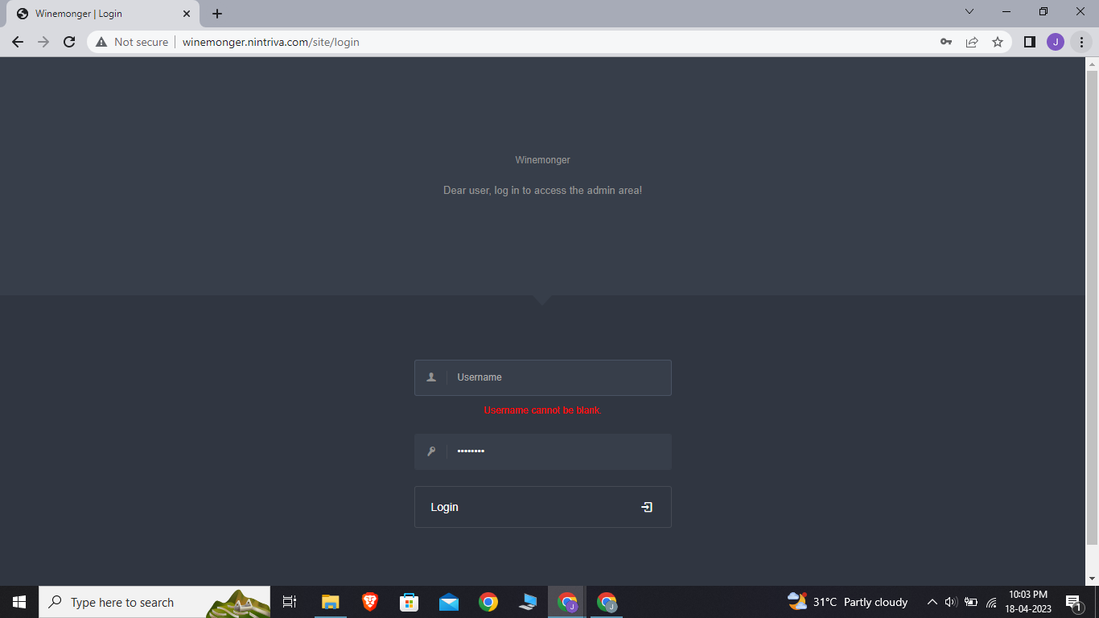
Login page

Slide 12
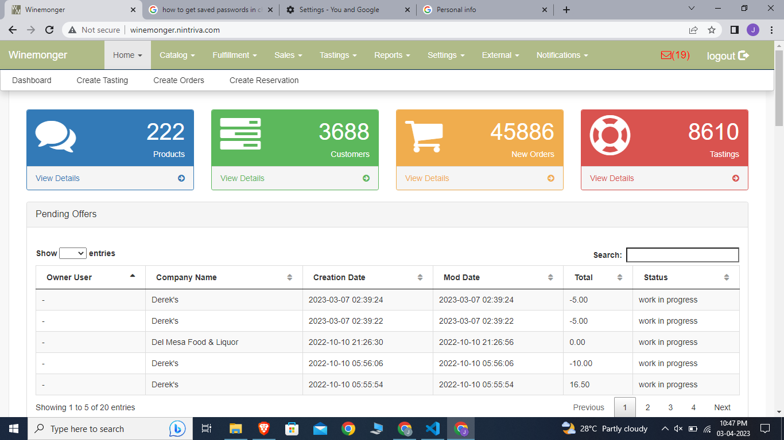
Home page

Slide 13
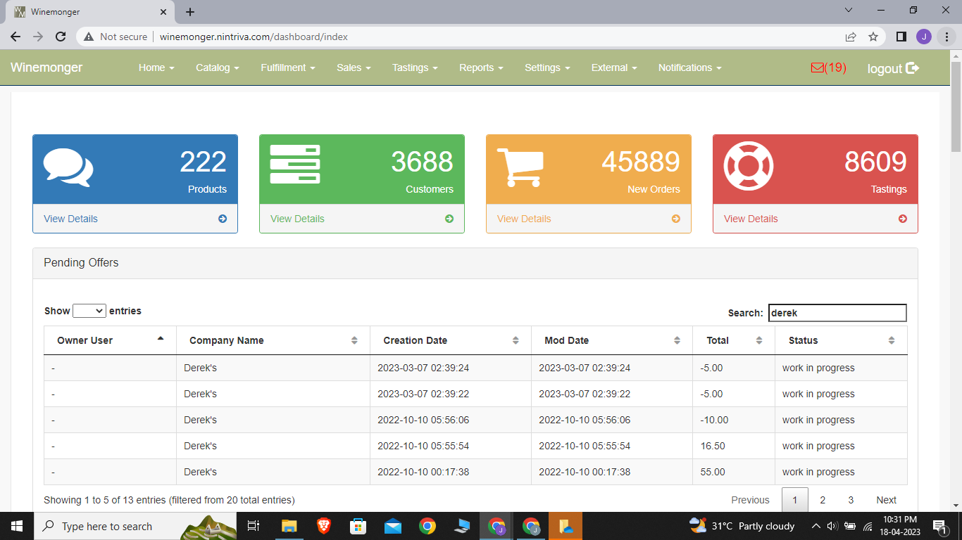
Home page

Slide 14
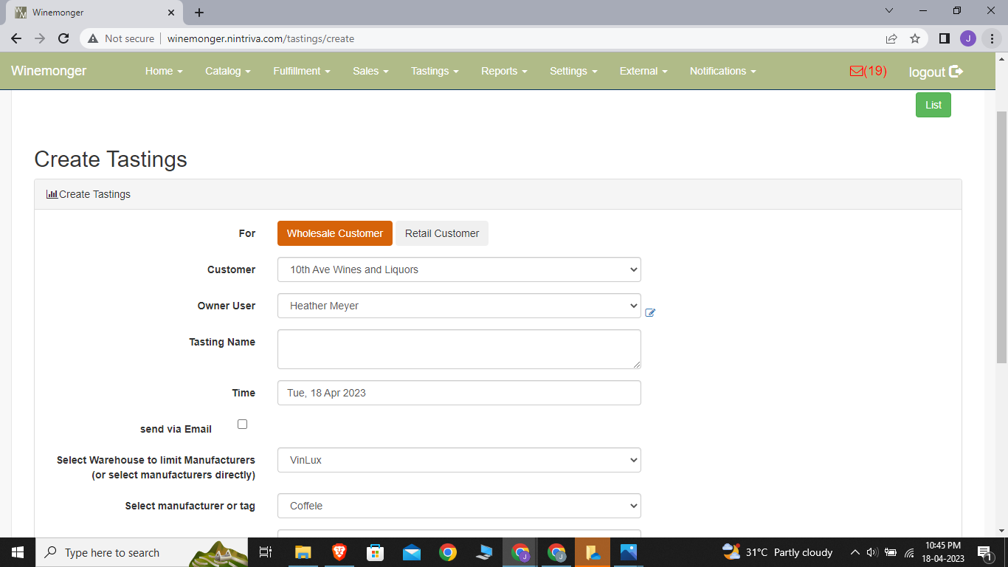
Login page

Slide 15
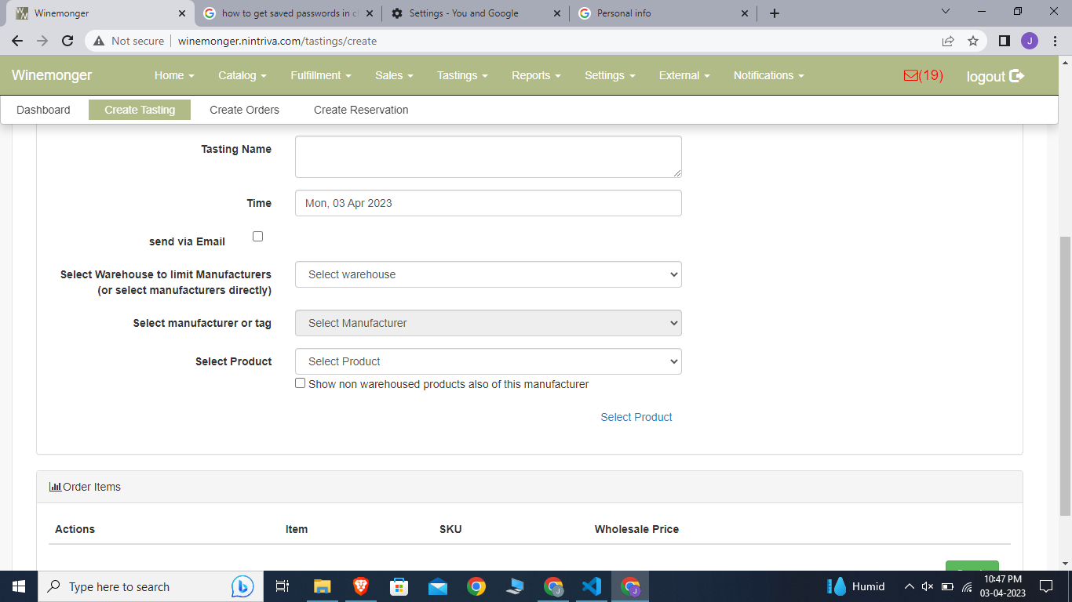

Slide 16
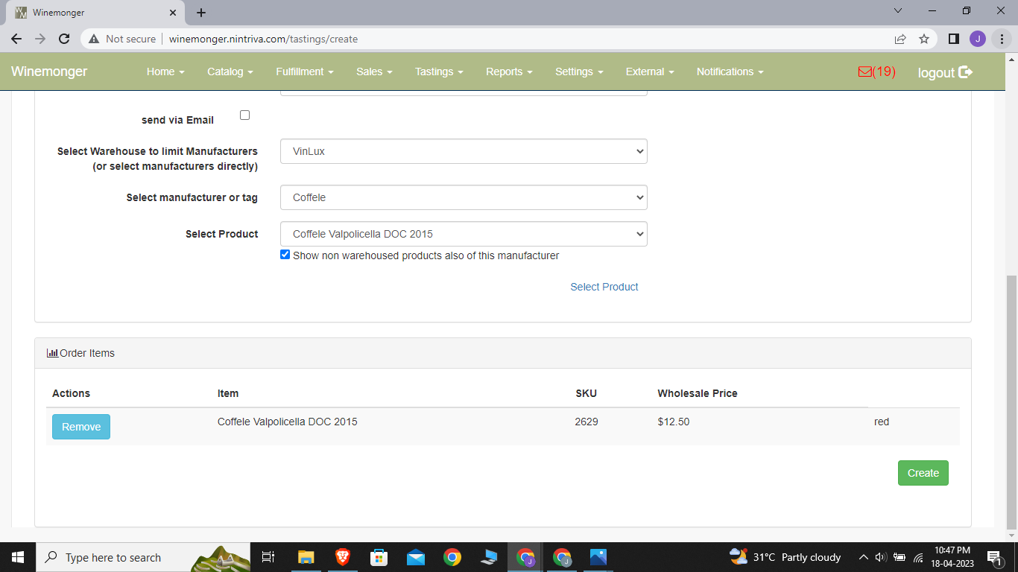

Slide 17
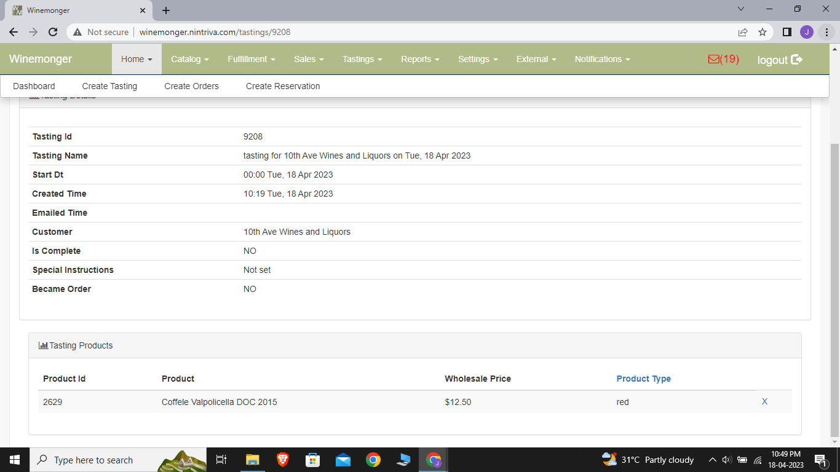

Slide 18
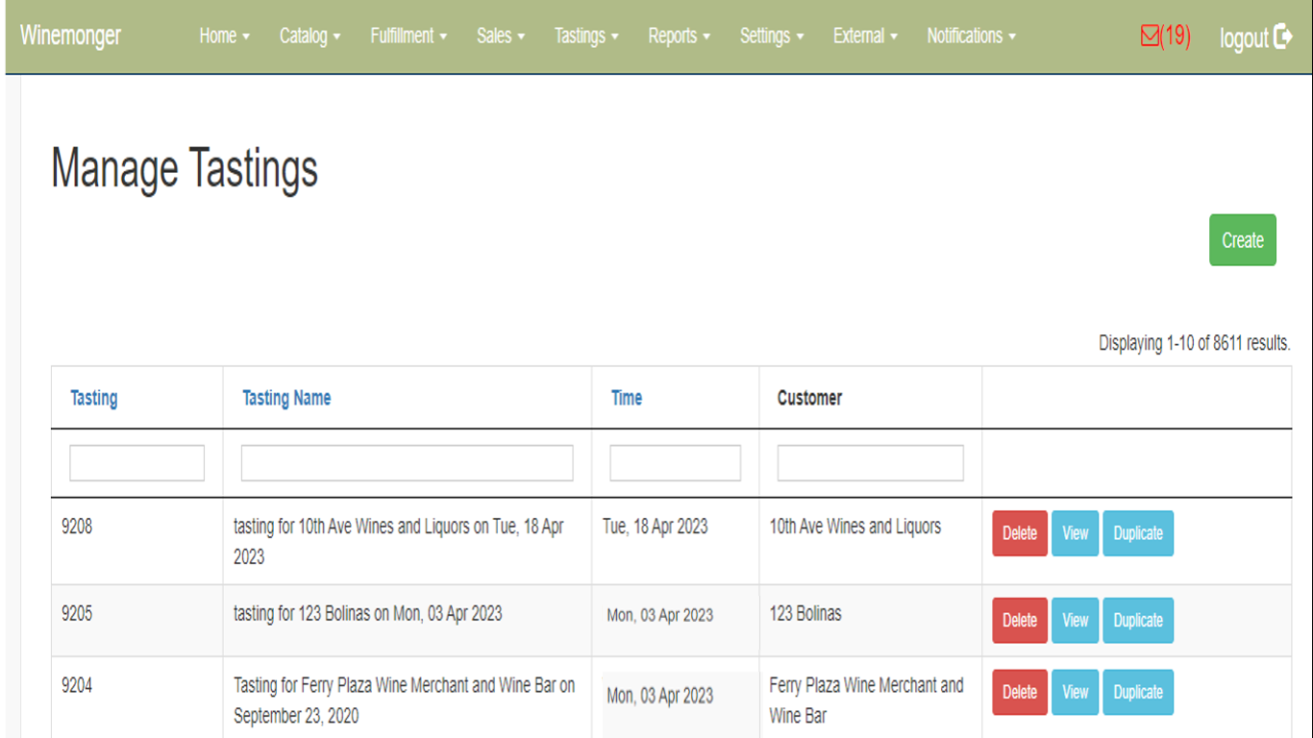
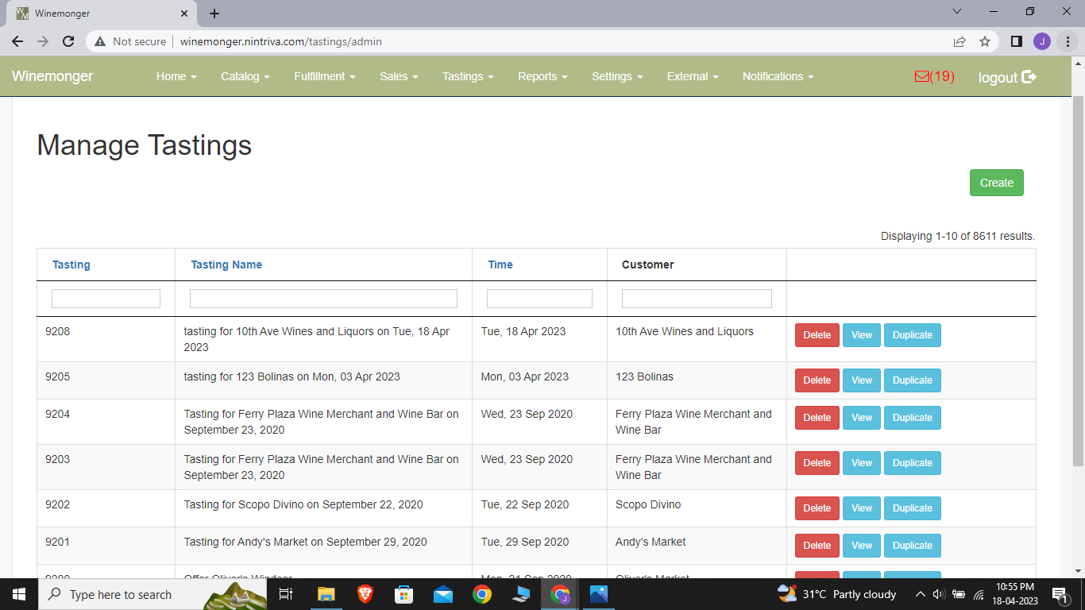

Slide 19
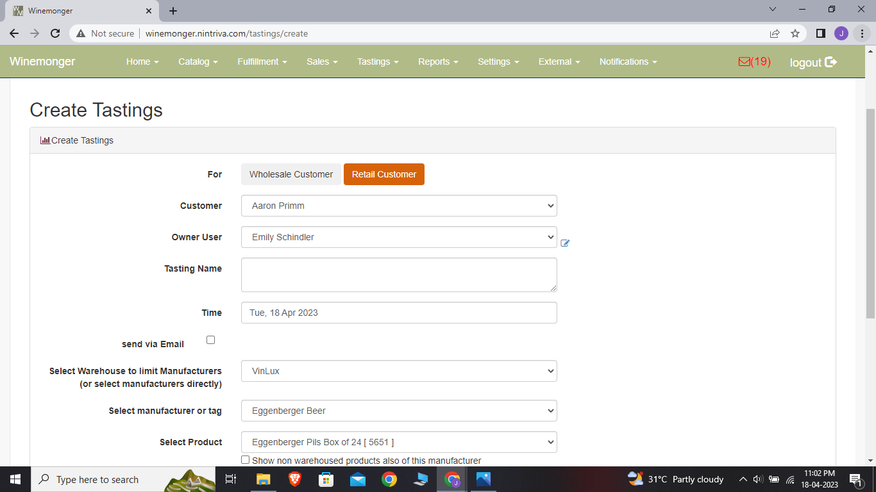

Slide 20
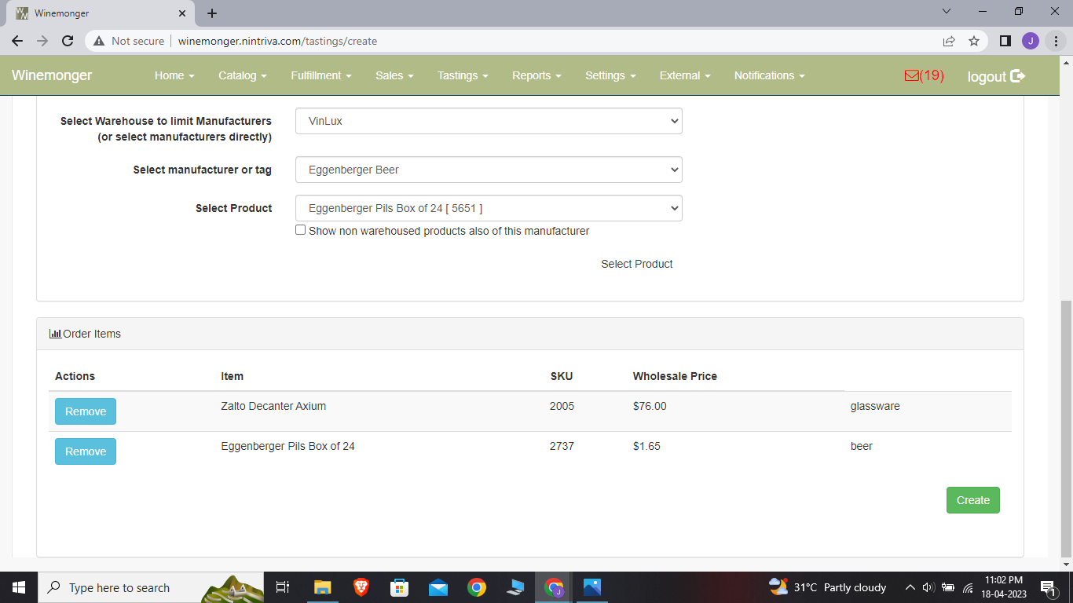

Slide 21
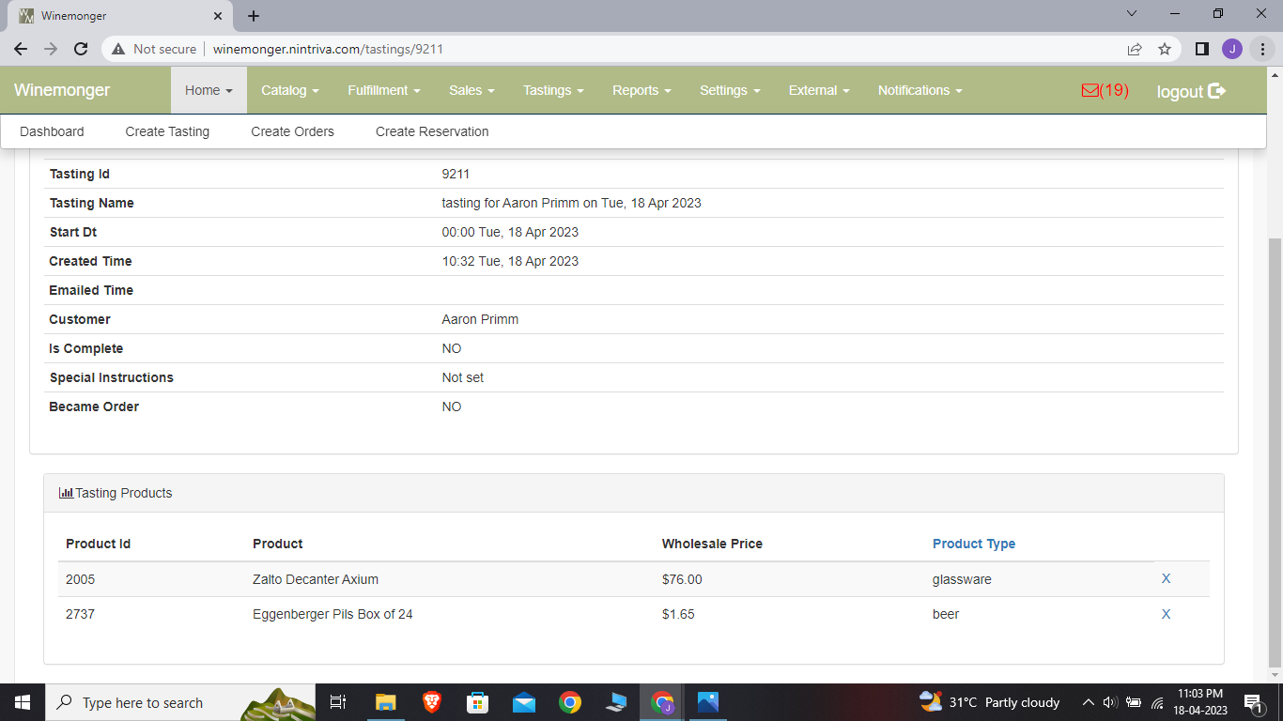

Slide 22
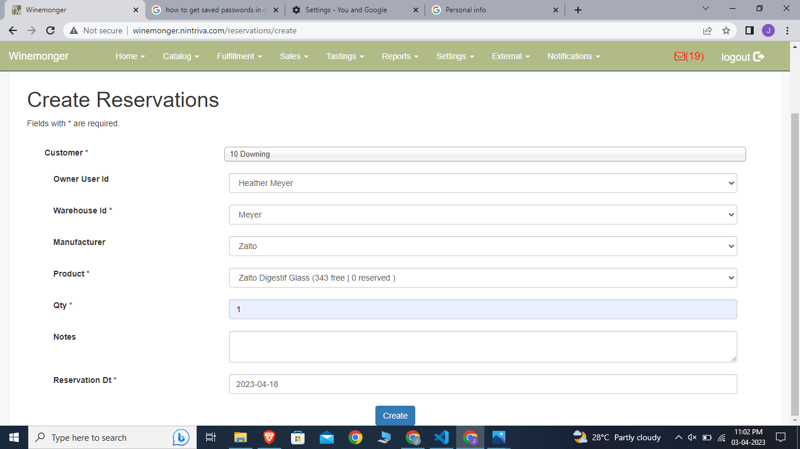

Slide 23
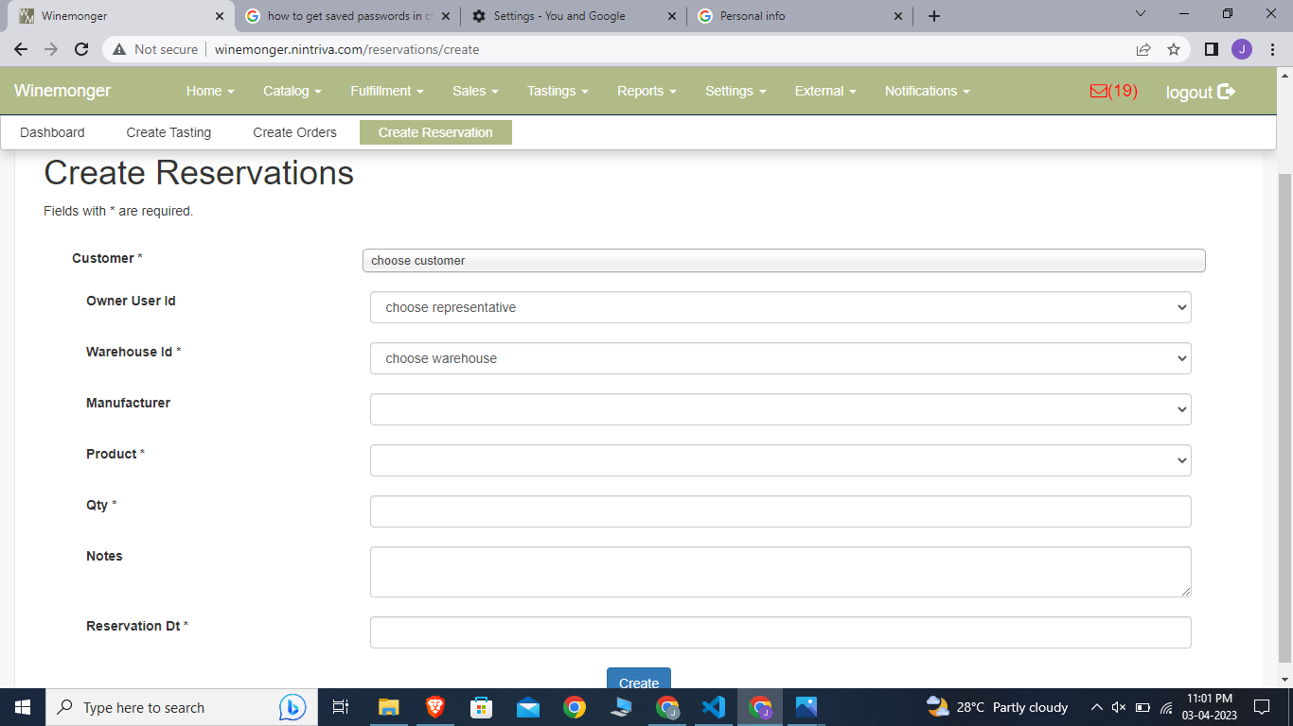

Slide 24
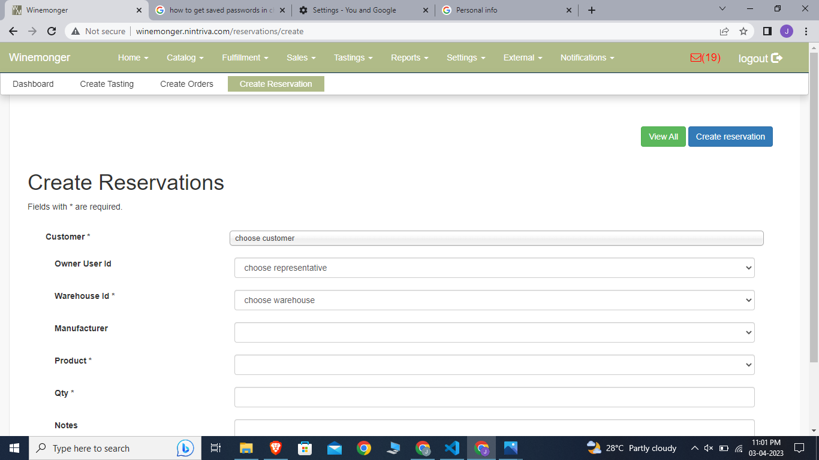

Slide 25
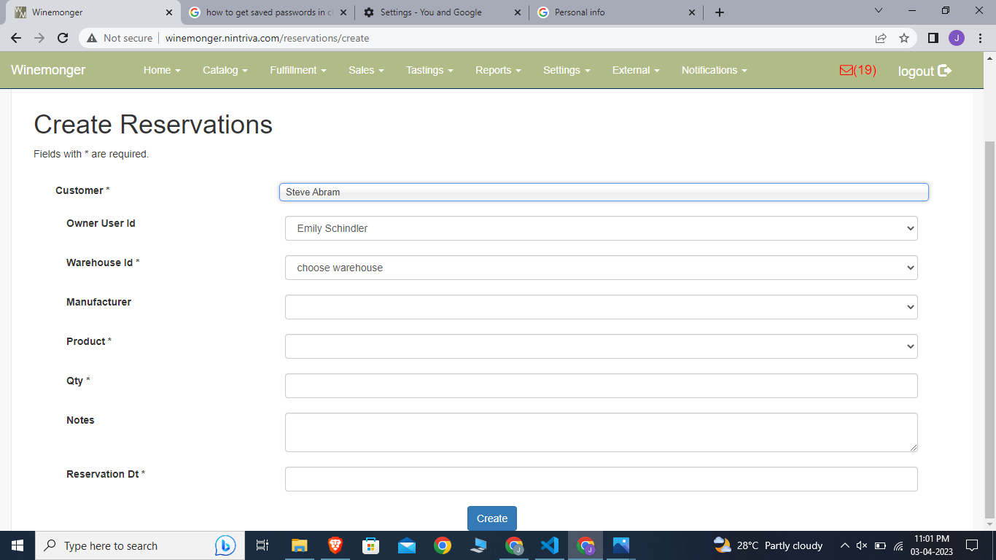

Slide 26
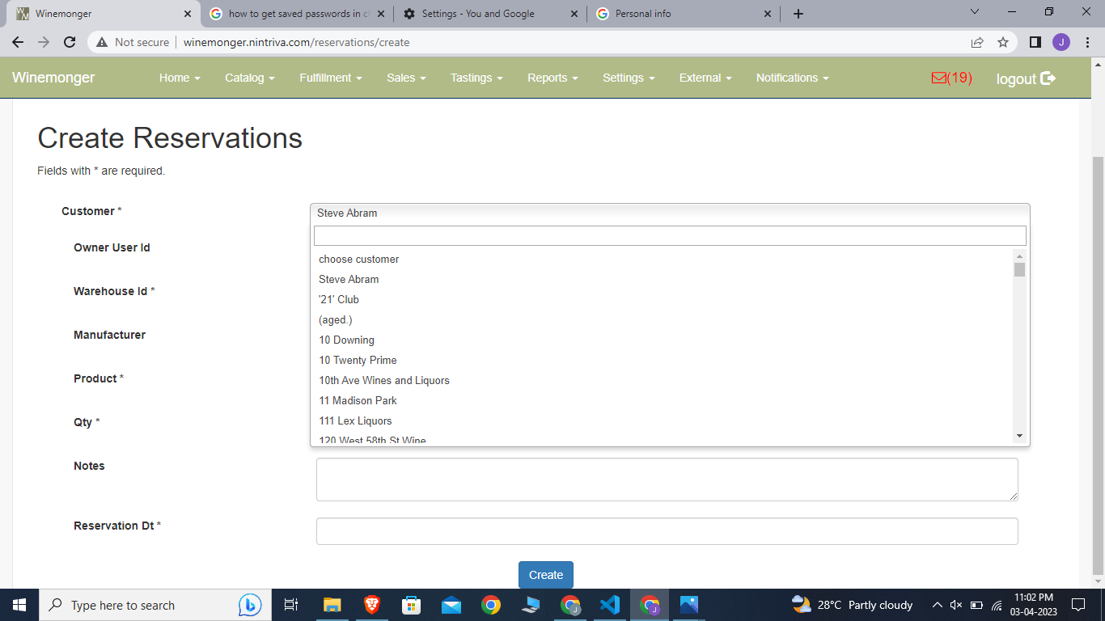

Slide 27
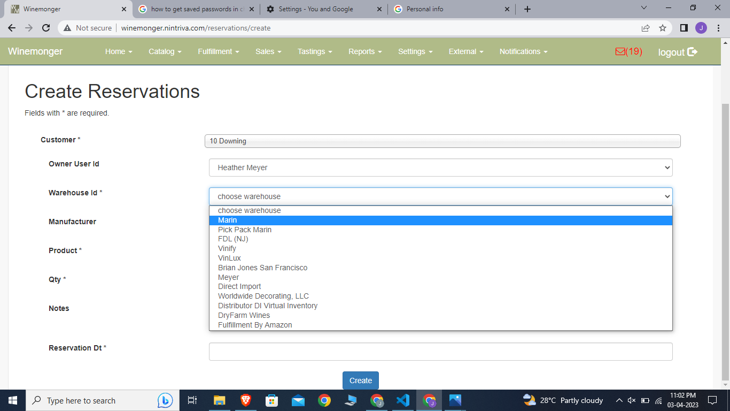

Slide 29
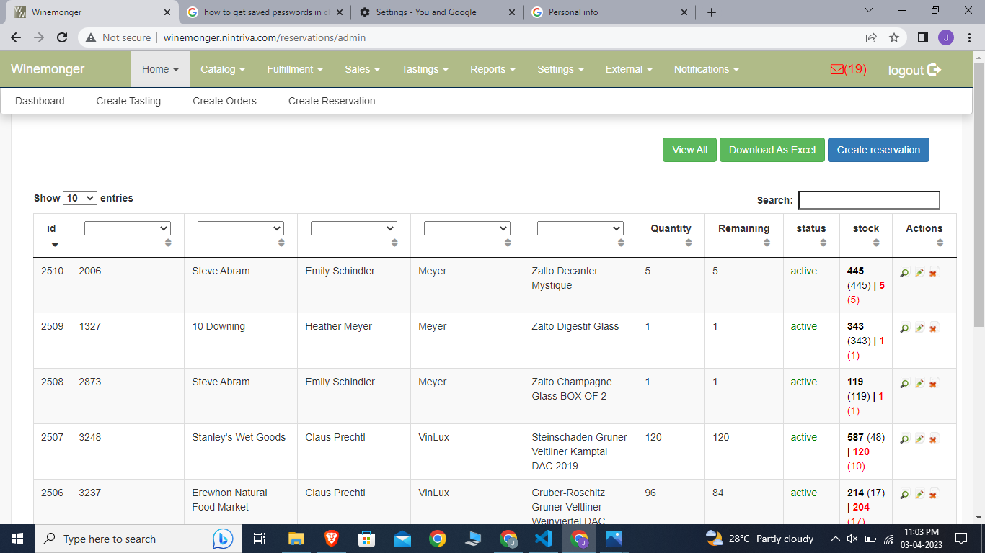

Slide 30
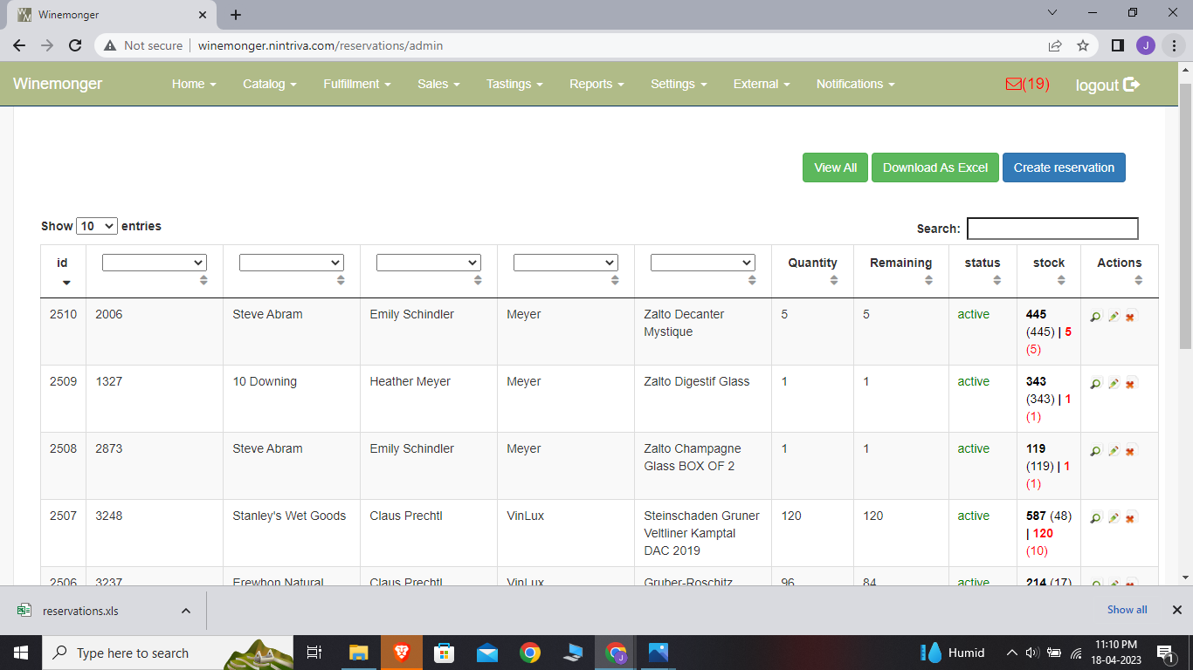

Slide 31
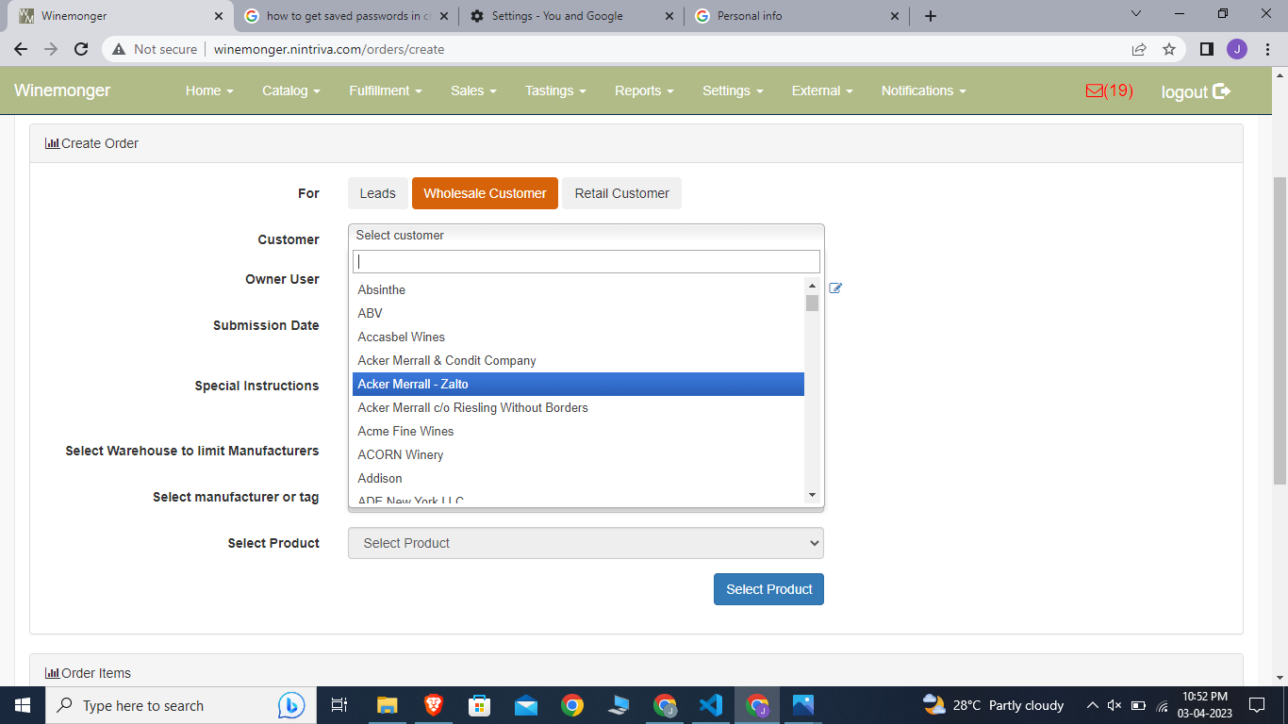

Slide 32
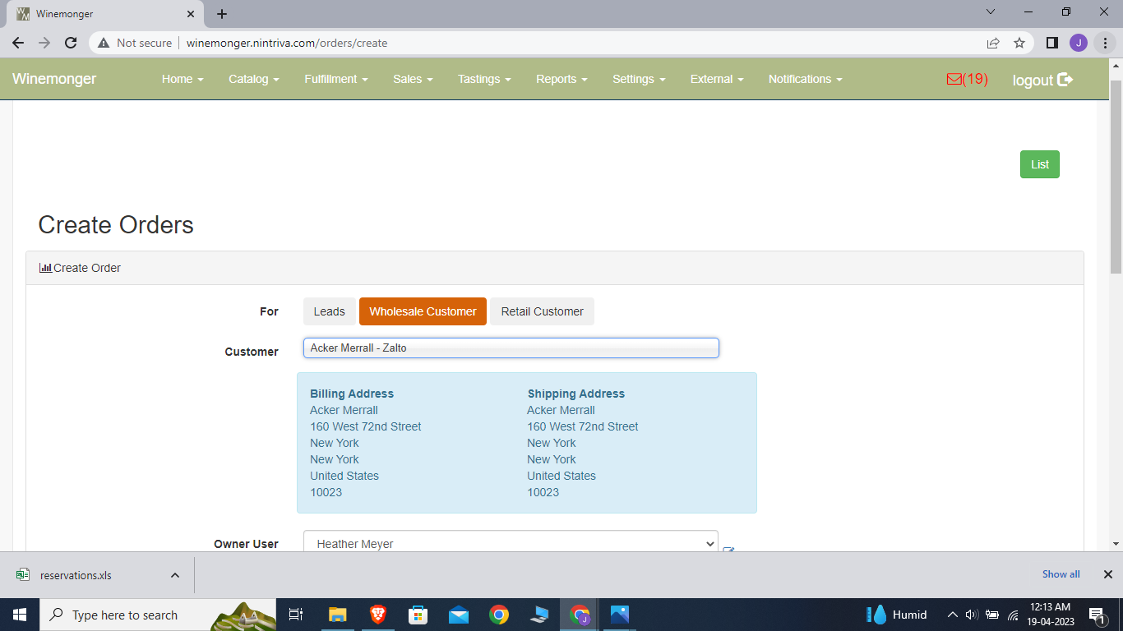

Slide 33
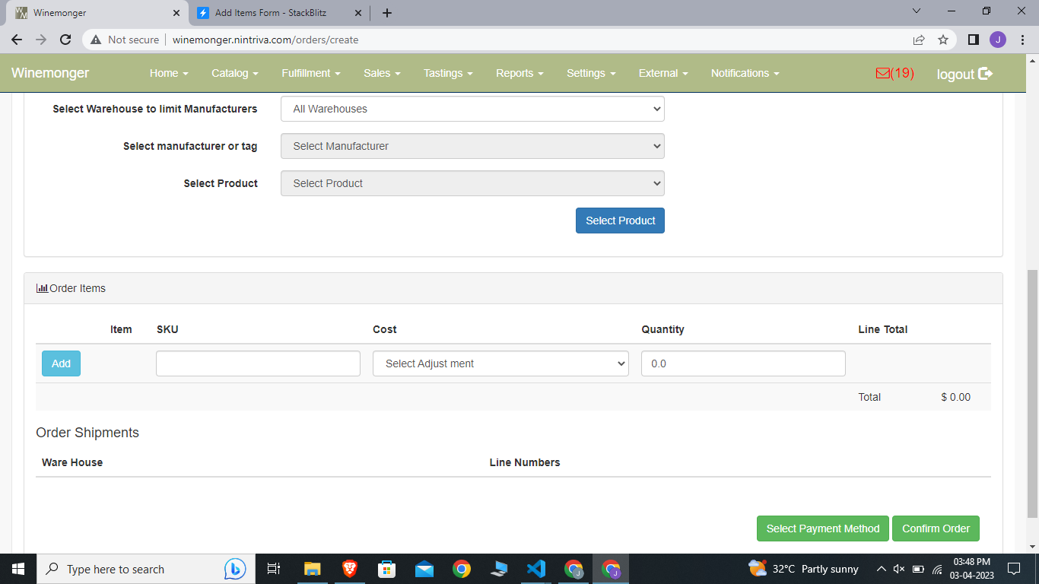

Slide 34
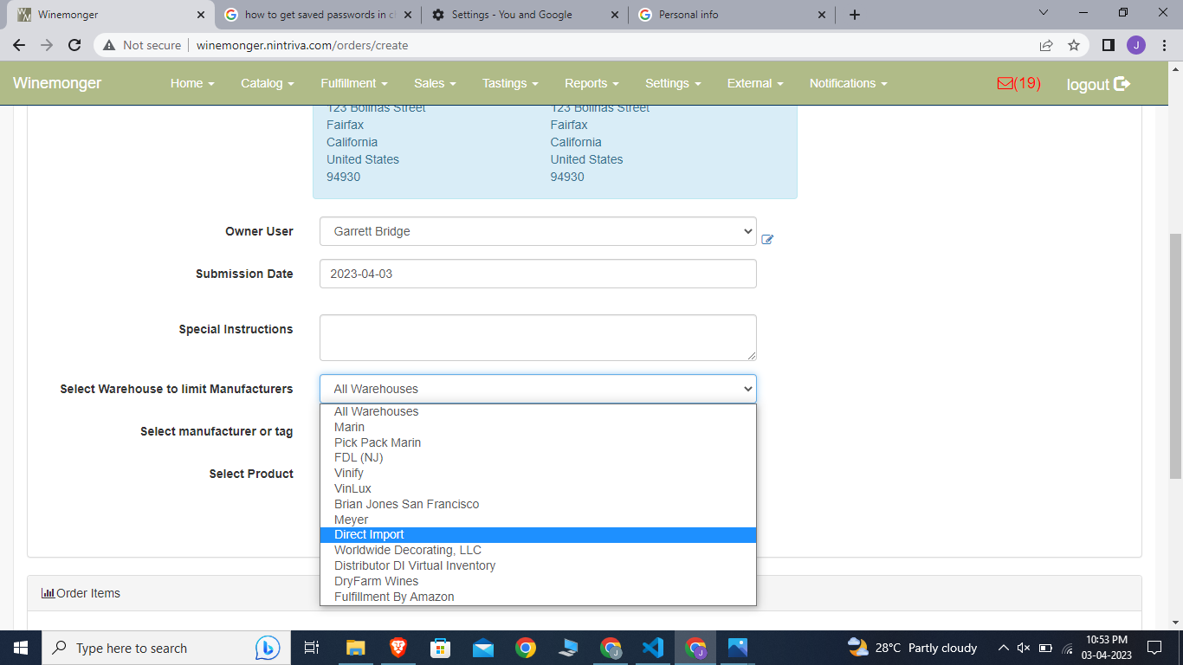

Slide 35
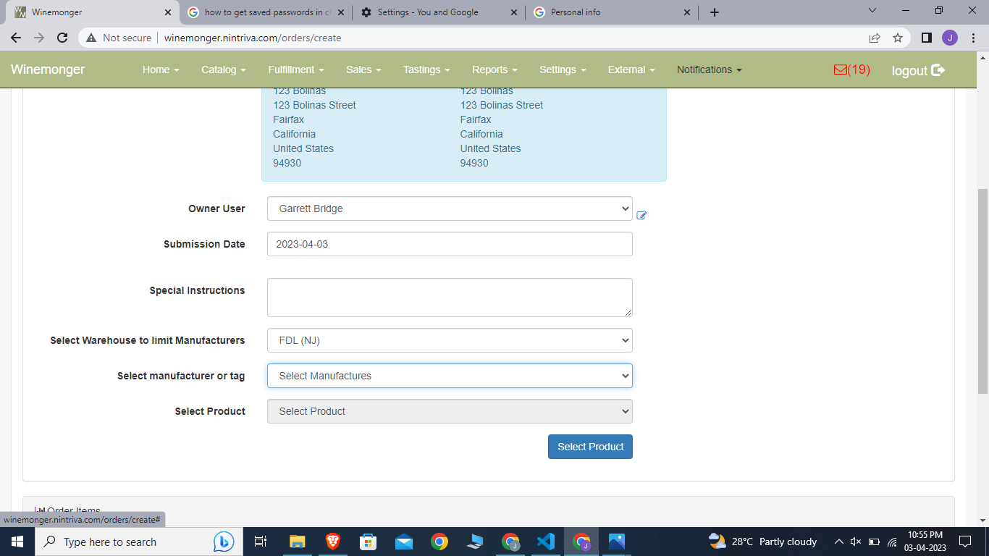

Slide 36
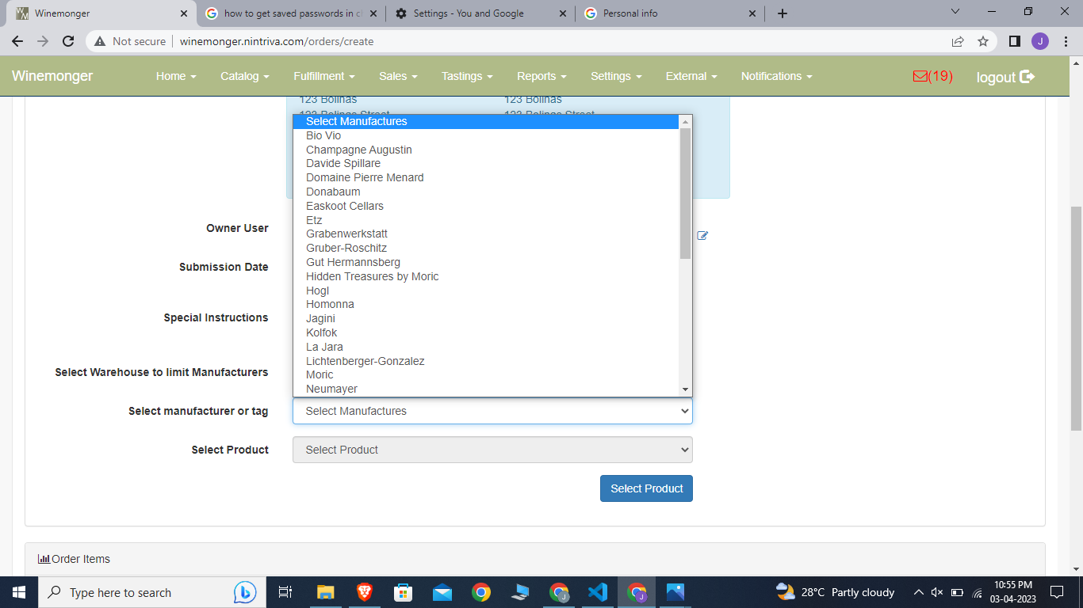

Slide 37


Slide 38
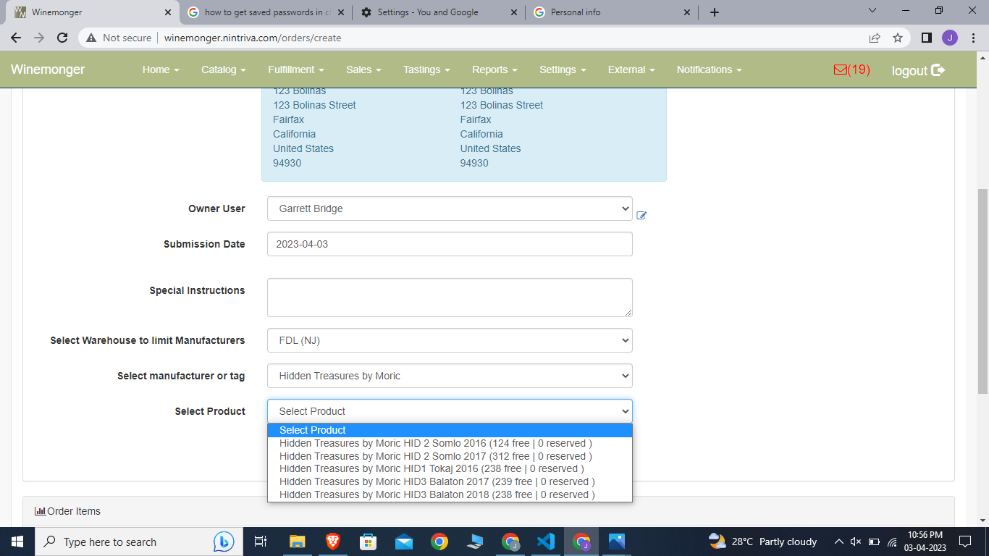

Slide 39
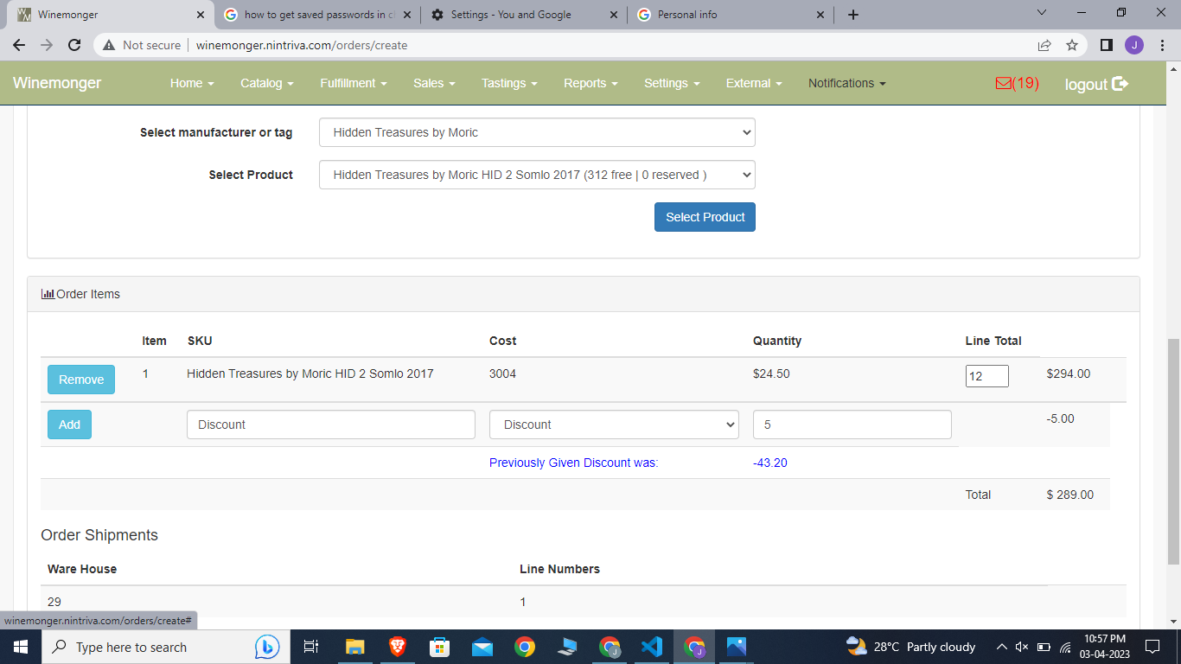

Slide 40
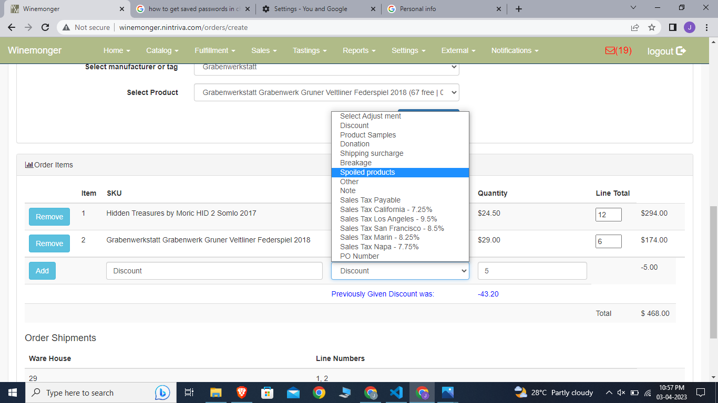

Slide 41
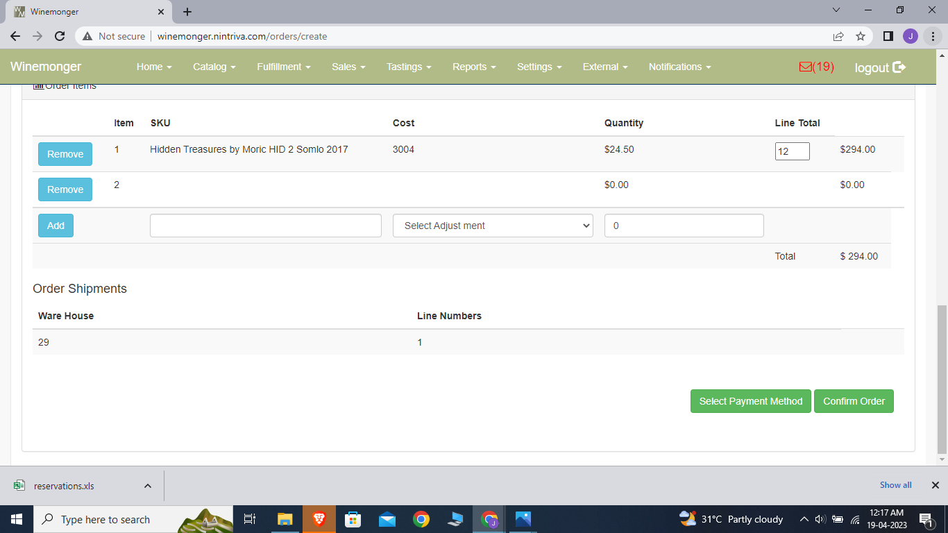

Slide 42
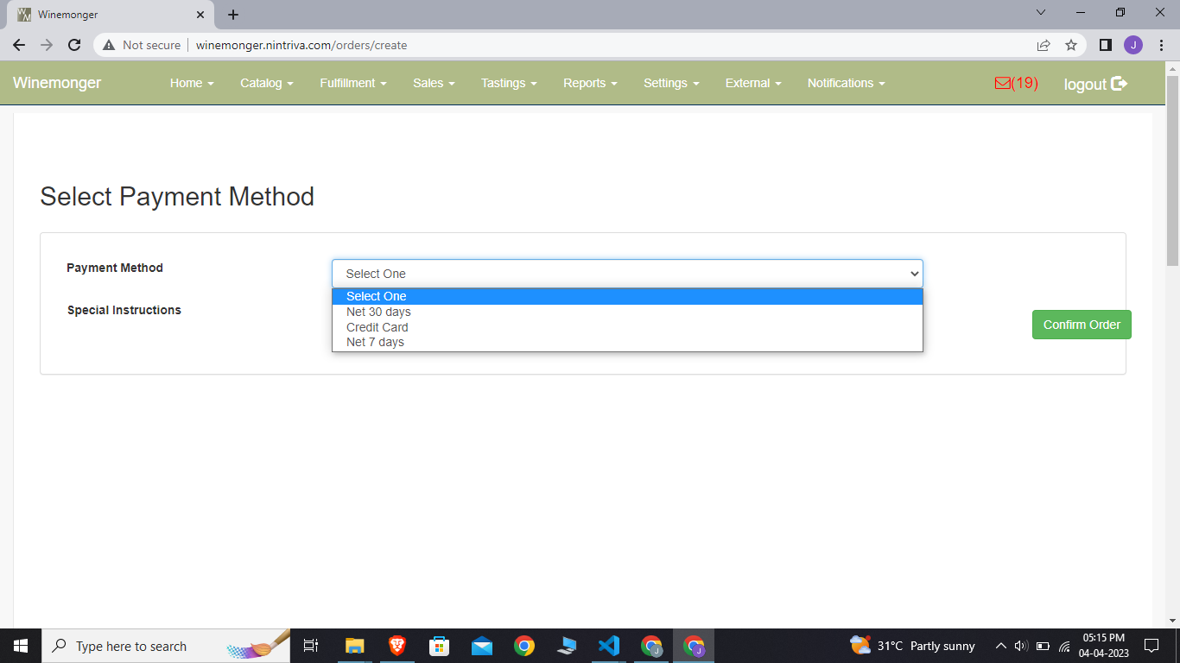

Slide 43
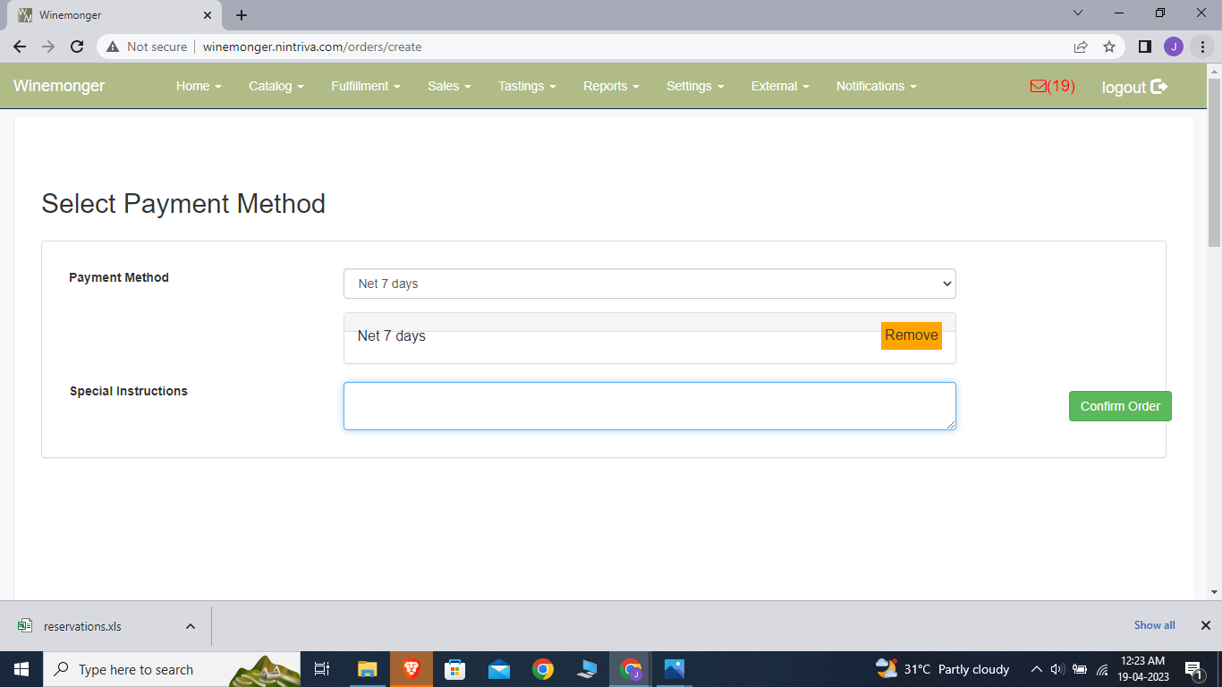

Slide 45
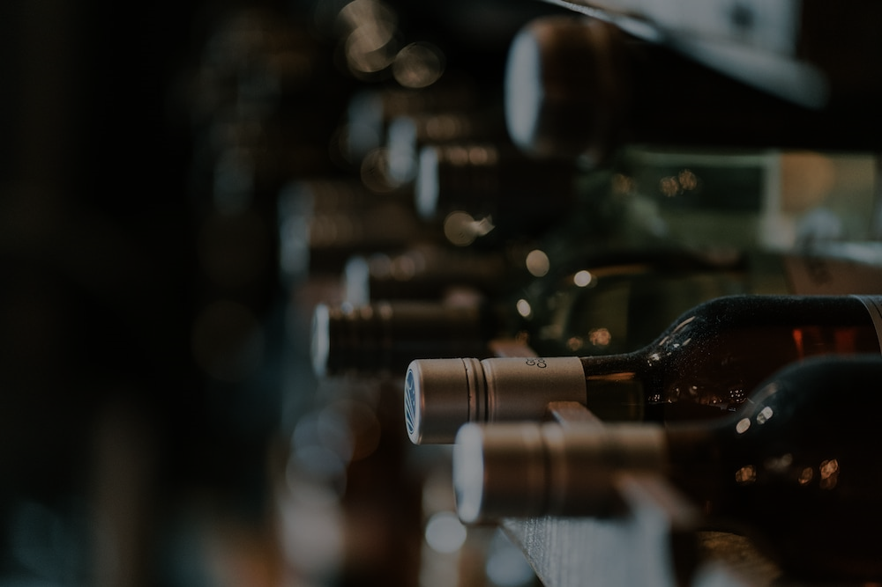
THANK YOU

